Slide 1
Welcome

Slide 2
Hydrogen
Fuel for the future?

Slide 3
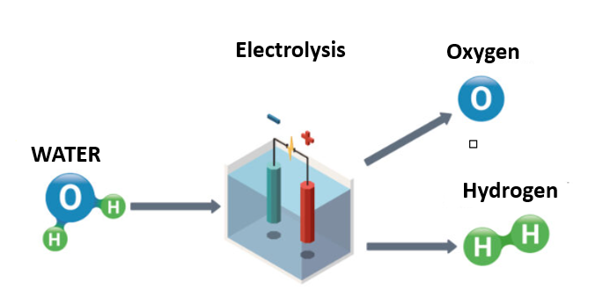
Hydrogen the future?
Hydrogen is only sustainable when it’s made from water or sustainable generated electricity.
We must therefore ensure that we can generate sufficient sustainable energy to produce hydrogen.
Best way to produce this Hydrogen is by electrolysis, water is split into hydrogen and
oxygen. This requires electricity. Green hydrogen is made by using sustainable
electricity generated by the sun, wind and water.
One kilogram hydrogen contains about 33kWh. To produce this kg takes about 50kWh electricity so the efficiency is about 70%. To compress and store the produced hydrogen cost another 15-20kWh. The total efficiency to produce, store and transport Hydrogen is about 50%.
Roughly speaking you can say that it takes 2kWh to produce, store and transport 1kWh of green Hydrogen.

Slide 4
Hydrogen anno 2023 and future
In Holland we use about 40 billion m3 natural gas per year.
25% from the natural gas is converted into (gray) hydrogen and used as a raw material in the chemical industry - for example the ammonia and certain plastics production and in refineries.
In Holland 105PJ hydrogen is produced from natural gas. (1 Peta Joule is a 1 with 15 zeros)
NorthH2 vision: (Shell and partners)
“The ambition is to generate around 3 to 4 GW (35PJ) of wind energy for hydrogen production by 2030, and possibly 10 GW (85PJ) in 2040.”
In 2030 20-30% gray hydrogen will be replaced by green hydrogen and in 2040 80%!
This means that in 2040 still 20% hydrogen will be produced gray.

Slide 5
Hydrogen facts and figures
The caloric value of hydrogen is about 1/3 of natural gas. This means there is three times the amount (m3) needed to have the same amount of power.
Hydrogen (when produced green) will not pollute any CO₂ . But , because of higher flame temperatures, it will produce more NOx. Probably NOx abatement will be required when hydrogen is used as a fuel to burn.
Since there is no infrastructure available for the use of hydrogen it will take many years before hydrogen is available for commercial use.
In 2040 80% of the hydrogen used in the Dutch industry will be green so 20% still gray.
So It will probably take until after 2040 before “small” consumers like us will get access to green hydrogen.

Slide 6
Hydrogen vs Electric
When we look into our industry the majority of the cremation take place during the day when green energy is available (Wind or Solar)
The DFW Electric cremators are much more efficient compared with the DFW gas cremators in their energy consumption. About 80% more efficient.
Hydrogen fueled cremators will not be more efficient than gas cremators and you need three times the amount of hydrogen compared to natural gas
Since Hydrogen is produced from electricity it is much more efficient to use the electricity as fuel for Electric cremator installations instead of burning it.
Why burn Hydrogen when an electric solution is available?

Slide 7
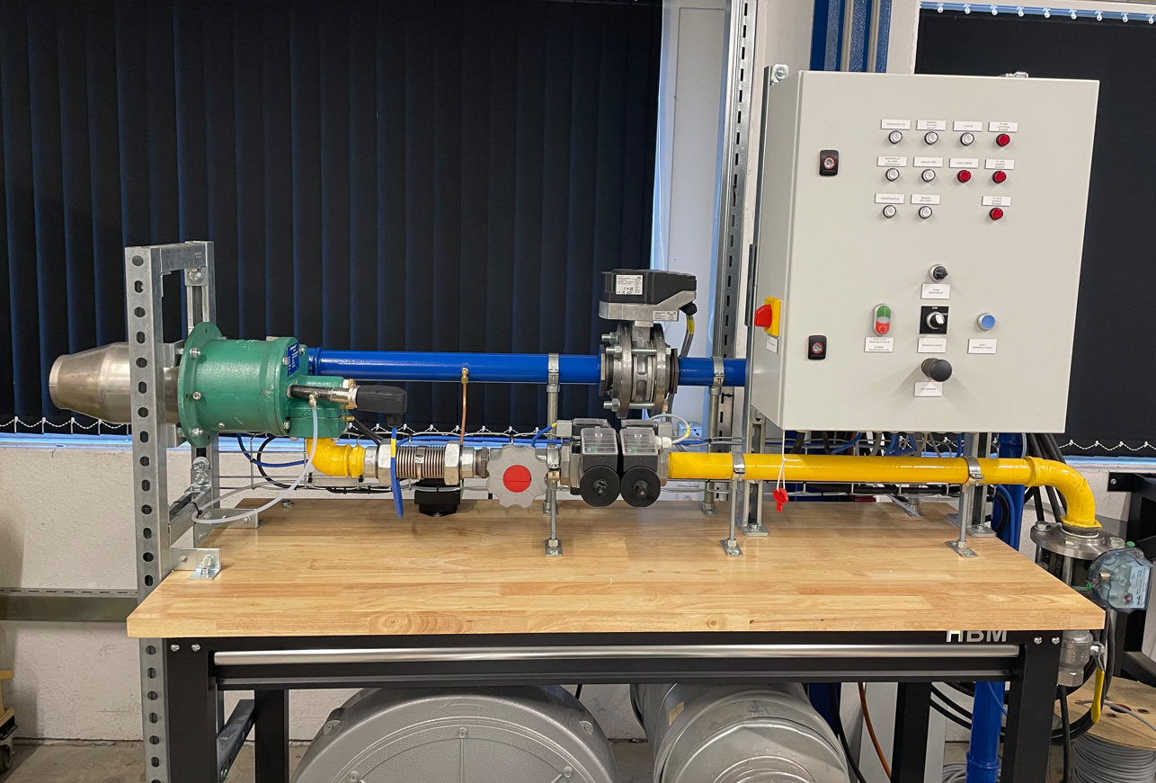
Hydrogen and DFW Europe
DFW Europe B.V. is developing a solution for the use of hydrogen in their cremators.
Our plan is to test a hydrogen burner in our factory this summer and convert a cremator in the UK in the first quarter of 2024.
We do this as partner in the HyCrem project from the Department for Business, Energy & Industrial Strategy (BEIS) in the UK. The test will take place in the Worthing crematorium where one of our 11 years old DFW6000 installations will be converted for the use of hydrogen.

Slide 8
www.dfweurope.com
+31 226 34 29 09
The End

